Slide 1
SURVEY ON CRACK DETECTION IN CONCRETE STRUCTURES
21BEC1497 – C SAI KOUSHIK

Slide 2
OUTLINE
INTRODUCTION: Overview on crack detection, significance and applications, role of machine learning
PROBLEM STATEMENT
OBJECTIVE
LITERATURE SURVEY: methods, algorithms, results, limitations and conclusion
REFERENCES: citations for the research papers used for the survey

Slide 3
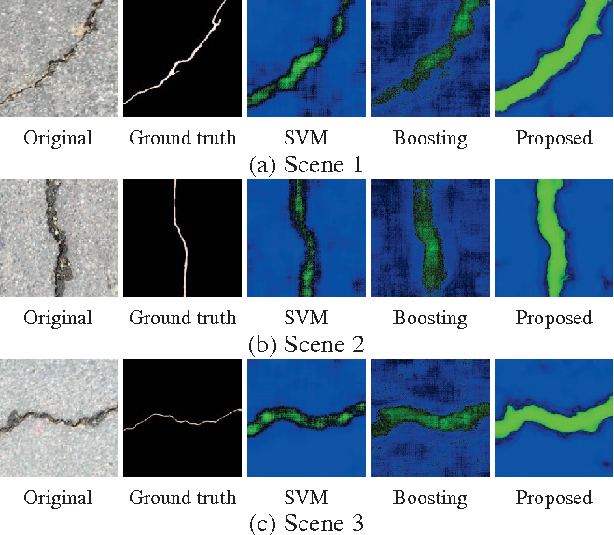
INTRODUCTION: Concrete buildings are subjected to fatigue stress that leads to cracks. Early detection allows preventive measures to be taken to prevent damage
Crack detection is the process of detecting the crack in the structures using any of the processing techniques.
Type, number, width and length of the cracks shows the earliest degradation level and carrying capacity of the concrete structures.
For fast and reliable defect analysis, Automatic crack detection is developed instead of the traditional human inspection.
CRACK DETECTION
DESTRICTIVE TESTING
NON- DESTRUCTIVE TESTING

Slide 4
There is an increasing interest in image-based crack detection for non-destructive inspection.
Difficulties in the image based detection are because of the random shape and irregular size of cracks, irregularly illuminated conditions etc. Because of its simplicity in the processing, many of the image processing detection methods were proposed. These methods are classified into four categories
In this survey 10 research papers are taken related to crack detection, and those research papers are reviewed
NON-DESTRUCTIVE TESTING
INFRARED AND THERMAL TESTING
ULTRASONIC TESTING
LASER TESTING
RADIOGRAPHIC TESTING
ETC
IMAGE PROCESSING DETECTION METHODS
INTEGRATED ALGORITHM (COMBINING MULTIPLE TECHNIQUES)
MORPHOLOGICAL APPROACH (SHAPE,SIZE,SPATIAL ARRANGEMENTS)
PERCOLATION BASED APPROACH (DATA POINTS ARE NODES, FINDING CLUSTERS)
PRACTICAL TECHNIQUE (CLASSIFICATION METHODS)

Slide 5
PROBLEM STATEMENT
BACKGROUND: Concrete structures, such as buildings, bridges, and pavements, require periodic examination to maintain their reliability and structural health. Visual signs of cracks and depressions indicate stress and wear and tear over time. If these cracks occur at critical locations (e.g., load-bearing joints), they can lead to failure or collapse.
OBJECTIVE: Manual inspection by experienced inspectors is time-consuming and relies on empirical knowledge, resulting in delays that compromise structural integrity. Hence, Automatic crack detection methods are relied on. The Automatic crack detection methods provide accurate, consistent and efficient results over manual inspections decreasing the time consumption.
CHALLENGES: Concrete cracks exhibit diverse patterns (e.g., fine cracks, wide gaps, irregular shapes).
Lighting conditions, surface textures, and environmental factors impact crack visibility.
Noise and artifacts in images can affect detection accuracy.
APPROACH:
Combining image processing techniques with machine learning algorithms.
Machine learning models (e.g., convolutional neural networks, decision trees) learn crack patterns from labeled data.

Slide 6
OBJECTIVES: The primary objective of this survey is to identify the research challenges and the achievements till in the field of crack detection and propose solutions to enhance the previous proposed methodologies.
REDUCED SUBJECTIVITY
SCALABILITY
AUTOMATED DETECTION
ENHANCED EFFICIENCY IN CRACK DETECTION
ACCURACY AND CONSISTENCY IN RESULTS
Handle diverse structures efficiently
Base decisions solely on data-driven patterns.
Ensure consistent results across different inspections
Reduce reliance on labor-intensive and error-prone human inspections
Process large datasets quickly, ensuring timely detection of cracks.

Slide 7
LITERATURE SURVEY
S.No : | Title/Author | Method/Technique Used | Algorithm Used | Advantages | Limitations
1. | Image-Based Crack Detection Methods: A Review Hafiz Suliman Munawar , Ahmed W. A. Hammad ,Assed Haddad , Carlos Alberto Pereira Soares and S. Travis Waller | Image Processing Methods: These methods involve manipulating the visual properties of images to enhance crack visibility and facilitate detection. Techniques include: Machine Learning Methods Machine Learning Methods: These methods involve training algorithms to learn patterns and features from crack images, enabling automated detection. Techniques include: | Filters: Commonly used for noise reduction and feature enhancement. Statistical Filtering: Utilized to remove noise and highlight structural features. Probabilistic Relaxation: Utilized to refine segmentation results by iteratively updating pixel labels based on local image statistics. Convolutional Neural Networks (CNN): Specialized for image analysis, CNNs automatically learn features from data hierarchically. Genetic Programming: Evolutionary computation technique for automatic generation of programs. Support Vector Machines (SVM): Learns decision boundaries between classes, often used for classification tasks. Artificial Neural Networks (ANN): Mimics the human brain's structure to learn and recognize patterns. | Effective in preprocessing images to improve crack visibility. - Can be computationally efficient for real-time applications. - May provide interpretability in terms of how cracks are enhanced or detected. - Can learn complex patterns and adapt to different crack types. - May generalize well to unseen data with proper training. - Offers potential for real-time applications once trained. - Can handle noisy and irregular data effectively. | May not handle complex crack patterns effectively. - Performance heavily dependent on parameter tuning. - Limited by the quality of input images and may not generalize well to unseen data. Requires a large amount of annotated data for training. - Training can be computationally intensive, especially for deep learning models like CNNs. - May suffer from overfitting if not trained properly. - Interpretability of results can be challenging in complex models like CNNs.

Slide 8
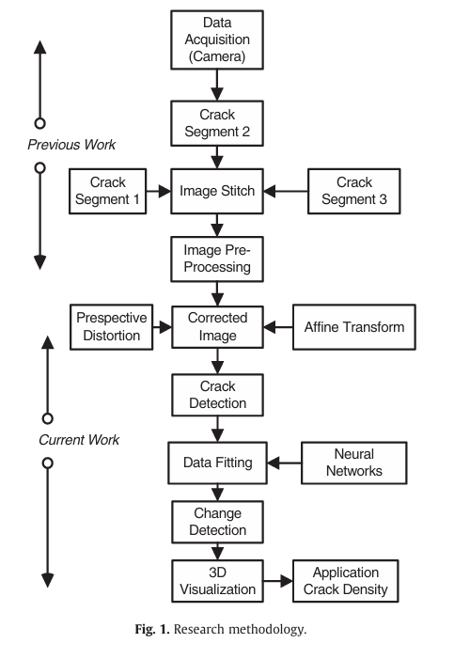
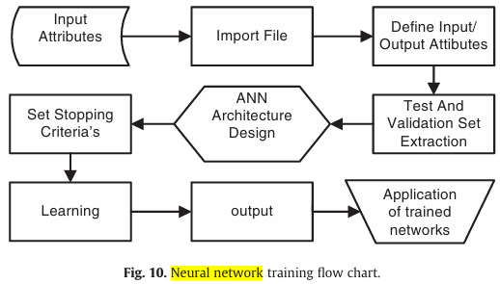
S.No : | Title/Author | Method/Technique Used | Algorithm Used | Advantages | Limitations
2. | Image-based retrieval of concrete crack properties for bridge inspection R.S. Adhikari , O. Moselhi 1, A. Bagchi | Integrated Model for Defect Representation: Combines digital image processing, crack quantification, neural networks, and 3D visualization. Quantification and Change Detection Models: Evaluate crack lengths and utilize Fourier Transform for temporal comparisons. Spectral Analysis and Visualization Models: Utilize spectral analysis for change detection and develop 3D visualization models. | Integrated Model: Neural networks, Fourier Transform, 3D modelling NEURAL NETWORK: maps relationship between crack depth and crack width. Input attribute: crack width Output attribute: crack depth Superior as compared to the Boosted Decision Tree models Spectral Analysis and Visualization: Google sketch-up | Quantification and Change Detection: accurate quantification of defects Offers insights into changes in crack patterns over time provides comprehensive 3D visual representation provide additional information about severity of cracks. | May require complex data processing and significant computational resources. Quantification and Change Detection: May require adjustments for different crack types, may be sensitive to image quality. The simplest way to describe the geometry of a defect is to collect the measurement of the defect by inspectors, but it is a time-consuming and costly task

Slide 9
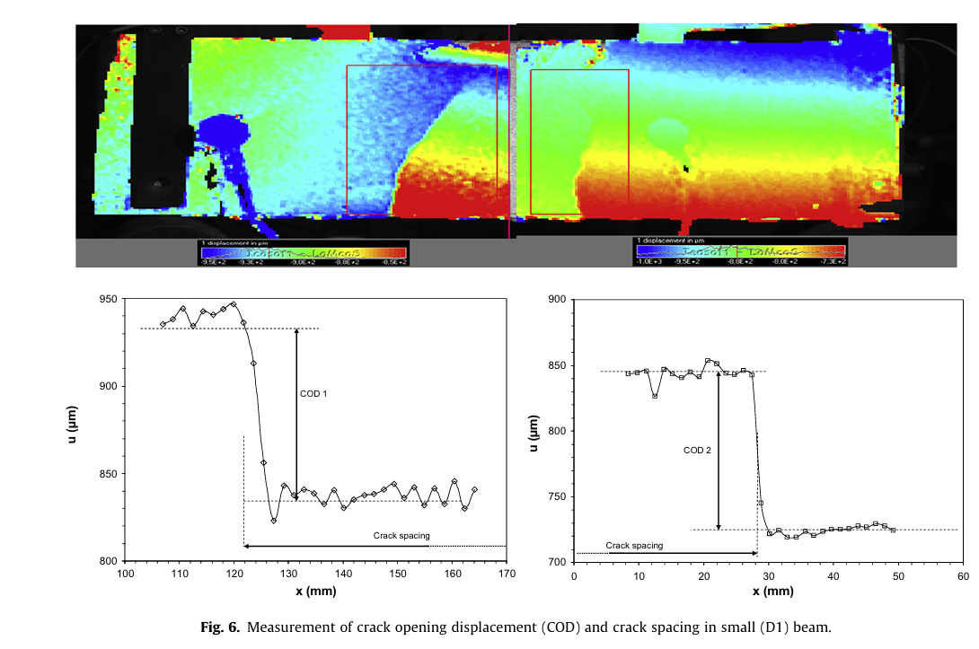
S.No : | Title/Author | Method/Technique Used | Algorithm Used | Advantages | Limitations
3. | Use of the digital image correlation and acoustic emission technique to study the effect of structural size on cracking of reinforced concrete S.Y. Alam⇑, A. Loukili, F. Grondin, E. Rozière | Digital Image Correlation (DIC): DIC is a non-contact optical technique used to measure full-field displacement and strain distributions on the surface of materials. In this study, DIC was employed to measure crack openings and spacing in reinforced concrete beams. Acoustic Emission (AE): AE is a non-destructive testing technique that detects and analyzes acoustic signals emitted by materials undergoing deformation or damage. In this research, AE was utilized to identify internal damage mechanisms in reinforced concrete beams. | Digital Image Correlation (DIC): Optical image processing algorithms. Acoustic Emission (AE): Signal processing algorithms. K-means algorithm is used to grouping for classification of crack types (micro, macro, surface) | Digital Image Correlation (DIC): Provides detailed, full-field measurements of displacement and strain, allowing for precise crack measurement and analysis. Acoustic Emission (AE): Enables real-time monitoring of structural integrity, allowing for early detection of damage and characterization of fracture processes. | Digital Image Correlation (DIC): Limited to surface measurements, may require complex calibration. Acoustic Emission (AE): Limited to detecting active damage events, interpretation may require expertise.

Slide 10
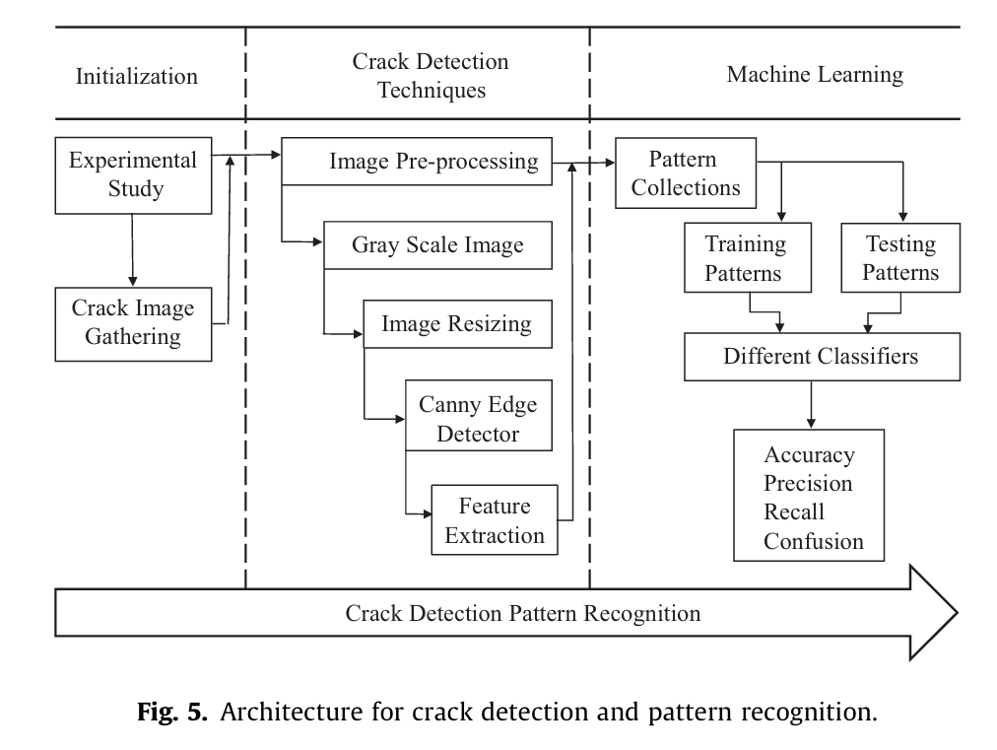
S.No : | Title/Author | Method/Technique Used | Algorithm Used | Advantages | Limitations
4. | Machine learning model for predicting the crack detection and pattern recognition of geopolymer concrete beams Aravind Na, Nagajothi Sb, Elavenil Sb VIT CHENNAI | Crack acquisition of experimented geopolymer concrete beams with BFRP & GFRP bars. Well-equipped image pre-processing python packages used to collect crack patterns. Automated quality check using machine learning python packages. Support Vector Machine (SVM) is used to classify the failure patterns.(Three classes of pattern failures were considered: flexure, shear, and compression failure) SVM compared with other five machine learning classifiers using confusion matrix. | Canny edge detection (Feature extraction) To train the patterns and predict the failure pattern in the images Support vector machine (SVM) Decision tree classifier Gaussian NB classifier SGD classifier K- neighbour classifier Adaboost classifiers SVM: Kernel: Linear, Gamma: 0.0001, Test size: 0.4 (40%) | Fiber-Reinforced Polymer (FRP) bars that are non-corrosive, light weight, and environment friendly in nature The performance and accuracy of SVM is the best among all the classifiers. | The performance of machine learning models is highly dependent on the quality and quantity of training data. The study's findings may be limited to the specific conditions and materials used.

Slide 11

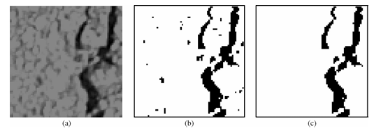
S.No : | Title/Author | Method/Technique Used | Algorithm Used | Advantages | Limitations
5. | Automatic Road Crack Detection and Characterization Henrique Oliveira, Member, IEEE, and Paulo Lobato Correia, Senior Member | Automatic Detection and Characterization: A system developed for identifying and describing cracks in road flexible pavement surfaces automatically, without reliance on manually labeled samples. Learning from Samples Paradigm: A method where the system learns to classify nonoverlapping image blocks as containing crack pixels or not based on examples rather than predefined labels. Crack Severity Level Assignment: A novel approach to categorize the severity of detected cracks according to their width. | Image Block Classification: Algorithm for determining if image blocks contain crack pixels. Connect Component Classification: Technique for characterizing types of cracks based on the connect components of detected cracks. Hierarchical, k-Means, Gaussian mixture model Severity Level Assignment Algorithm: Methodology for assigning severity levels to cracks based on width measurements. | Elimination of Manual Labeling: Reduces the need for labor-intensive manual sample labeling. Comprehensive Crack Analysis: Enables detailed detection and characterization of crack types and severity levels. Efficient Evaluation Methodology: Includes a systematic approach for quantitative evaluation and comparison with expert human assessments. | Dependence on Image Quality: The effectiveness of crack detection and characterization may be influenced by the quality of the pavement surface images. Algorithm Complexity: The complexity of algorithms might require significant computational resources for processing and analysis. Potential for Misclassification: While automated, the system may still be prone to errors in crack detection and severity assessment, especially in complex scenarios.

Slide 12
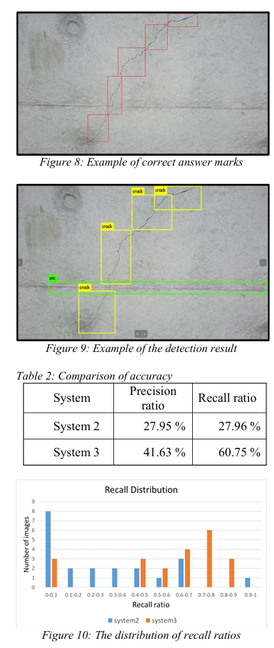
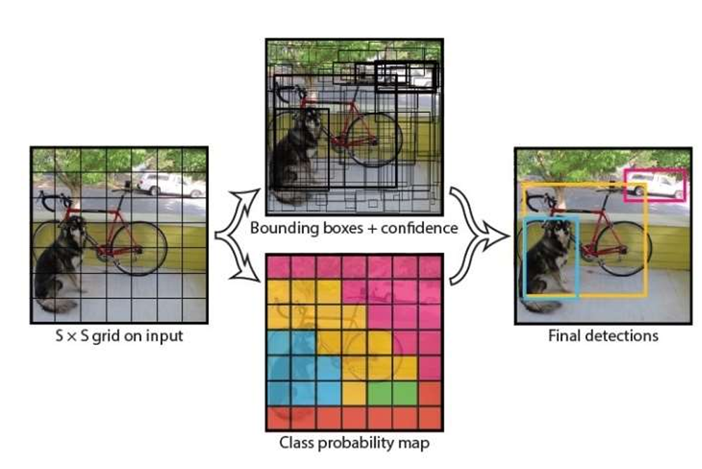
S.No : | Title/Author | Method/Technique Used | Algorithm Used | Advantages | Limitations
6. | Concrete Crack Detection Using UAV and Deep Learning Saki Murao Yasutoshi Nomura Hitoshi Furuta | Unmanned Aerial Vehicles (UAV) You Only Look Once (YOLO) can estimate the position, size, and type of an object in an Image | YOLOv2 DEEP LEARNING MOFEL (unspecified) | reduce cost and improve the efficiency of inspection work | the dropping of the robot, the insufficient quality of the photo images obtained from the motion pictures,

Slide 13
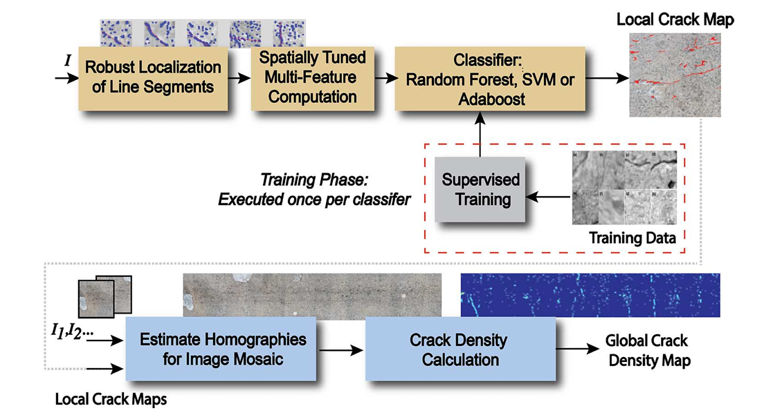
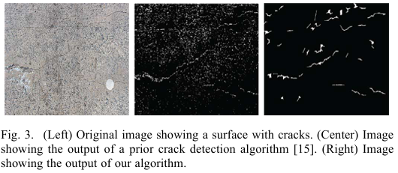
S.No : | Title/Author | Method/Technique Used | Algorithm Used | Advantages | Limitations
7. | Automated Crack Detection on Concrete Bridge Prateek Prasanna, Kristin J. Dana, Nenad Gucunski, Basily B. Basily, Hung M. La, Member, IEEE, Ronny Salim Lim, and Hooman Parvardeh | The STRUM{(spatially tuned robust multifeature} classifier consists of three components: 1) a robust line segment detector (on-site robotic scanning) 2) spatially-tuned multiple feature computation (Laplacian pyramids) 3) a machine learning classifier. | Support Vector Machines (SVM): SVM is utilized for classification based on extracted features to distinguish between crack and non-crack samples . Adaboost and Random Forests: These algorithms are also employed for classification tasks in the automated crack detection process | eliminate the need for manually tuning threshold parameters The algorithm achieves up to 95% accuracy in crack detection, providing reliable results for bridge inspectors The algorithm provides quantifiable results that can be archived and compared over time, aiding in long-term bridge performance monitoring | key challenge is automated interpretation of the large image dataset in order to infer bridge condition presentation of the crack detection results may be made to a human inspector. There is a challenge of communicating spatial patterns of cracks over the entire bridge deck.

Slide 14
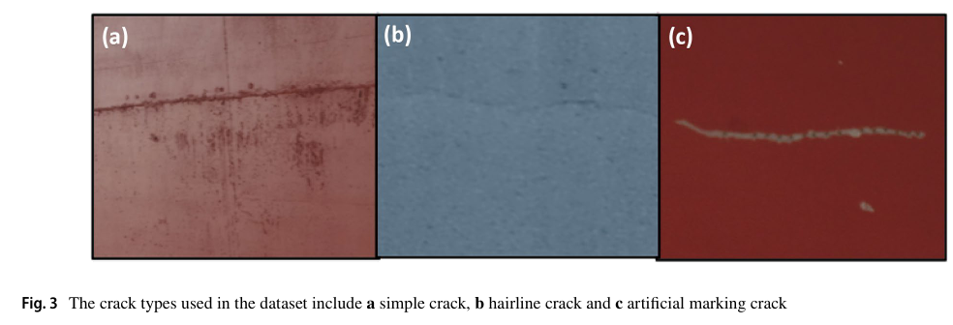
S.No : | Title/Author | Method/Technique Used | Algorithm Used | Advantages | Limitations
8. | Modern Crack Detection for Bridge Infrastructure Maintenance Using Machine Learning Hafiz Suliman Munawar1 · Ahmed W. A. Hammad1 · S. Travis Waller2 · Md Rafiqul Islam | method that is based on computer vision for automatically detecting cracks from 2D images convolutional neural network (CNNs): Cycle Generative Adversarial Network (Cycle-GAN): predicting the crack segmentation pixel by pixel in an end to-end manner Deeply Supervised Nets (DSN) and Fully Convolutional Networks (FCN) | Convolutional Neural Networks (CNNs) and Cycle Generative Adversarial Networks (Cycle-GANs), for crack detection in infrastructure images. CNNs are employed for image feature extraction and classification, while Cycle-GANs facilitate image-to-image translation without the need for labeled data | automates the crack detection process, reducing the need for manual inspection and increasing efficiency. accurate detection of cracks in infrastructure images, improving the overall reliability of maintenance assessments. The deep learning framework can be scaled to edge devices, allowing for real-time crack detection on-site. | The performance of the CNN and Cycle-GAN models may vary across different bridge structures and environmental conditions, impacting their generalization capabilities. require significant computational resources, potentially limiting their applicability in resource-constrained environments. Deep learning models are often considered as black boxes, making it challenging to interpret the decision-making process behind crack detection results.

Slide 15
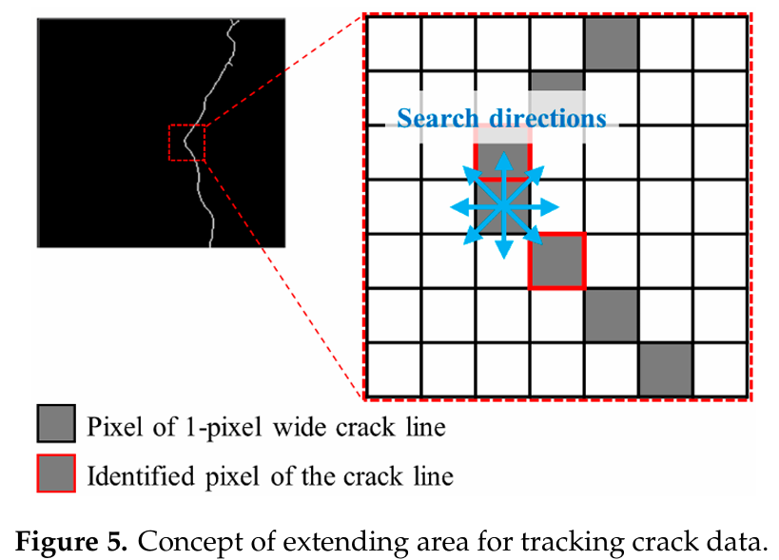
S.No : | Title/Author | Method/Technique Used | Algorithm Used | Advantages | Limitations
9. | Artificial Neural Network-Based Automated Crack Detection and Analysis for the Inspection of Concrete Structures Jung Jin Kim 1 ,Ah-RamKim2 andSeong-WonLee2, | image analysis technique using deep learning Three stages of image processing pipeline are proposed: first and second stages, two-dimensional convolutional neural networks(based on CNN: hierarchical feature learning architecture is applied) thinning and tracking algorithms are applied to analyze length and width of crack in the image cropping the input image to patches classification of concrete crack patches (CNN) segmentation of concrete crack measurement of crack characteristics. | CNN(12 layers) Rectified linear unit (ReLU) is used as an activation function determining the output of a neural network | can be applied not only to fixed-sized but also varied-sized images obtained in various environments (patch-wise approach and separated two neural networks) | the proposed method was trained and verified with limited data. limited data points cannot fully represent the variety of concrete cracks. (proposed method should be further verified with a larger data set) proposed crack measurement method is able to calculate the physical length and width of the crack when the physical length of a pixel is given

Slide 16
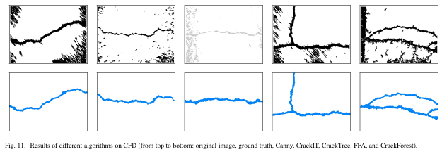
S.No : | Title/Author | Method/Technique Used | Algorithm Used | Advantages | Limitations
10. | Automatic Road Crack Detection Using Random Structured Forests Yong Shi, Limeng Cui, Zhiquan Qi, Fan Meng, and Zhensong Chen | Integral Channel Features: redefine the tokens that constitute a crack Random Structured Forests: which serve as a high-performance crack detector. These forests can identify arbitrarily complex cracks. New Crack Descriptor: to effectively characterize cracks and distinguish them from noises. | Random structured forests can exploit the structured information and predict the segmentation mask (token) of a given image patch. Binarization | superior to other state-of-the-art detecting techniques like CrackTree, CrackIT, FFA and MPS The use of integral channel features enriches the feature set for crack detection, improving the ability to capture the complex structure of road cracks. | method has only performed on static images so far. The video streaming is not taken into consideration The width of the crack is not measured

Slide 17
REFERENCES:
1. https://www.sciencedirect.com/science/article/pii/S1110016817300236
2.https://www.sciencedirect.com/science/article/pii/S0926580513001088
3.https://www.sciencedirect.com/science/article/pii/S0013794415003045
4.https://www.sciencedirect.com/science/article/pii/S0950061821015452
6.https://www.sciencedirect.com/science/article/pii/S0926580523001899
7. https://ieeexplore.ieee.org/document/6917066
8. https://link.springer.com/article/10.1007/s44230-022-00009-9
9. https://www.mdpi.com/2076-3417/10/22/8105
10. https://ieeexplore.ieee.org/document/7471507

